Slide 1

React-Redux
With Thunk

Slide 2
What is an app state
App state

Slide 3
What is an app state (context)
App state

Slide 4
What is redux?
Redux is a pattern and library for managing and updating application state, using events called "actions"
App state
action
Reducer:
Predictable way

Slide 5
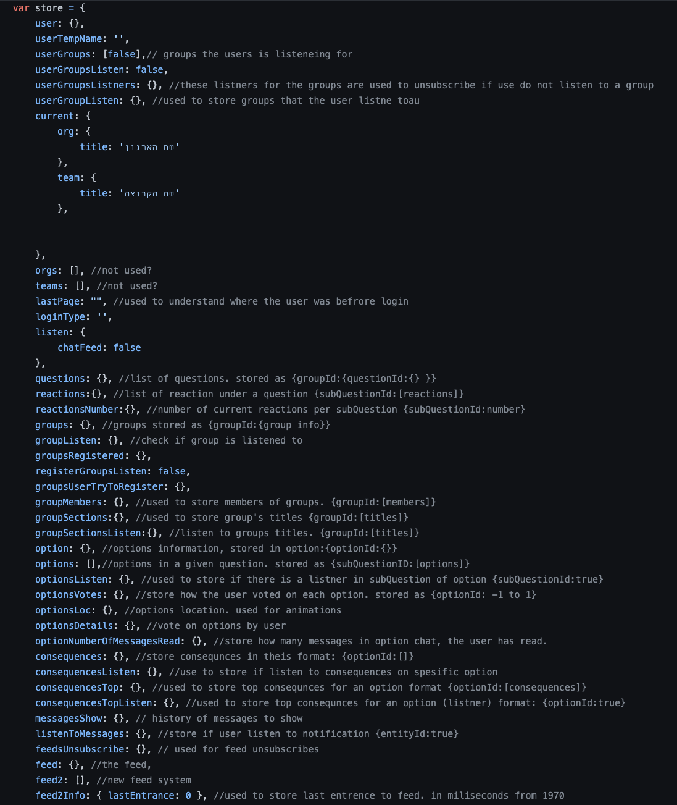
Why Should I Use Redux?
The patterns and tools provided by Redux make it easier to understand when, where, why, and how the state in your application is being updated, and how your application logic will behave when those changes occur.

Slide 6
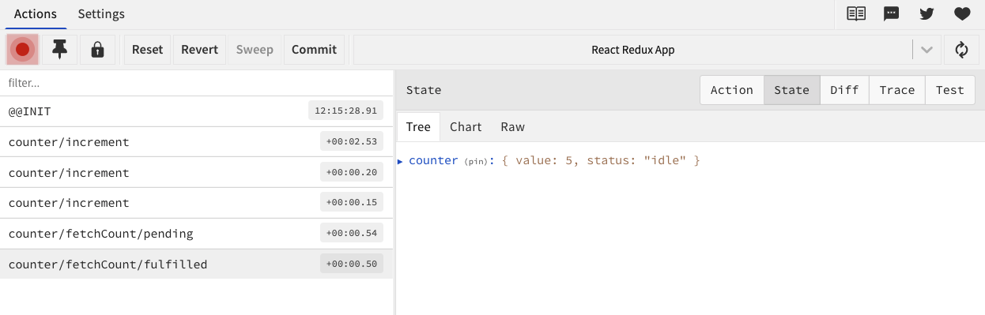
Why Should I Use Redux?
The patterns and tools provided by Redux make it easier to understand when, where, why, and how the state in your application is being updated, and how your application logic will behave when those changes occur.

Slide 7
Data in redux: immutable
App-state
dataSlice
dataSlice(diff)
dataSlice(diff)
dataSlice(diff)

Slide 8
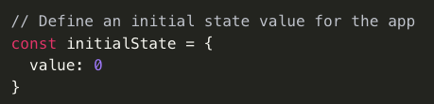
Initial state

Slide 9
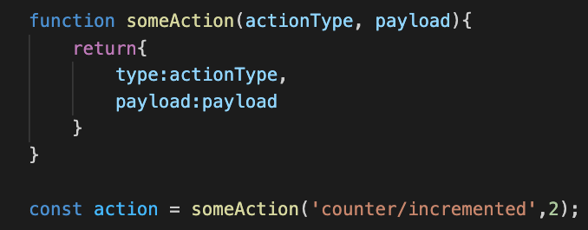
action: what kind of a change…

Slide 10
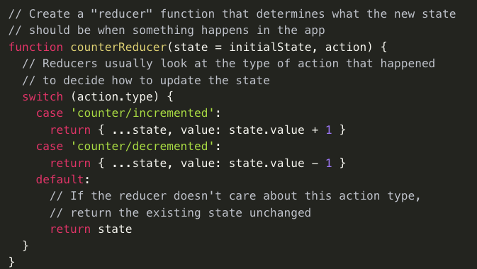
Reducer: changes the state…

Slide 11
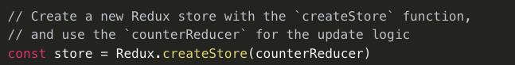
Store (state)

Slide 12
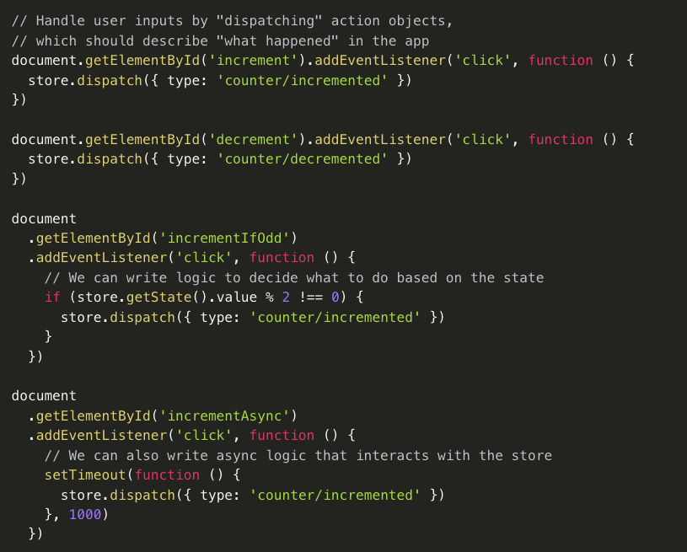
Dispatch actions

Slide 13
Dispatch dispatch/emmit + subscribe
Event driven app
rxJS /node js
Function
Emit(something)
Function subscribed(somthing)
Function
dispatch(something)

Slide 14
The cycle
Reducer:
Predictable way
store
Subscribe to selector
action
component
component
dispatch
Local state

Slide 15



exercise
action
Some text
Some text
Some text
Some text

Slide 16
exercise
Enter text
Some text
Some text
Some text
Some text
Enter text
Enter text
Enter text

Slide 17
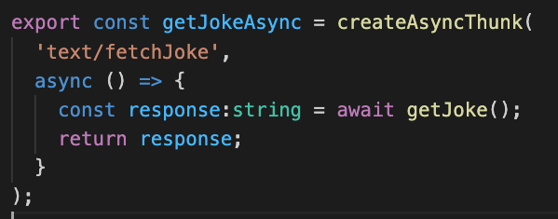
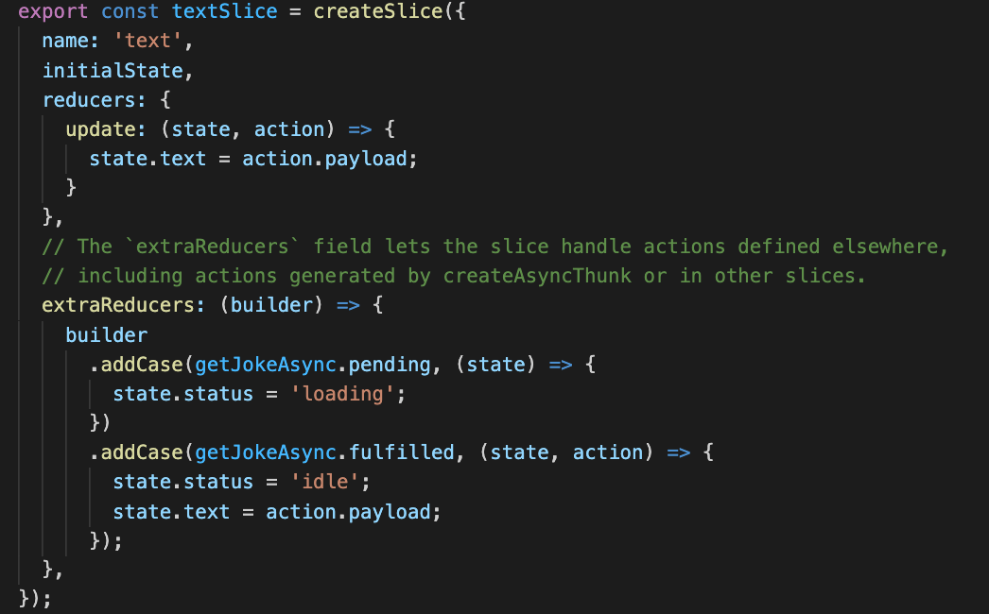
Async (Thunk)
Promise
Reducer:
Predictable way
store
action
component
Subscribe to selector
component
dispatch
Local state

